Slide 1
Classification of Histopathological Cancer Images using CNN on Apache Spark
Krishnamohan P
Ananth Sankar
Kausal Mahadas

Slide 2
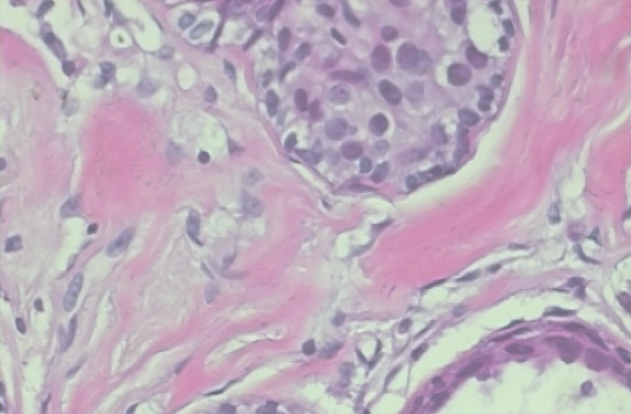
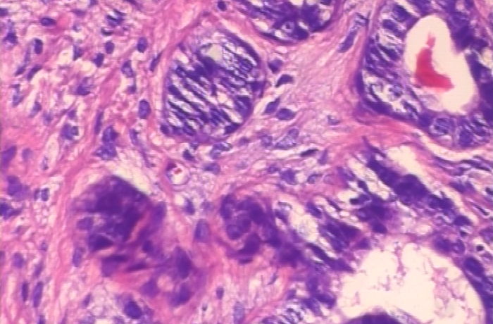
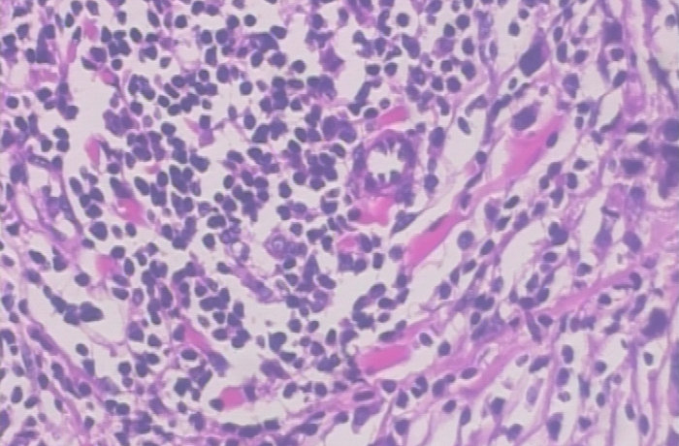
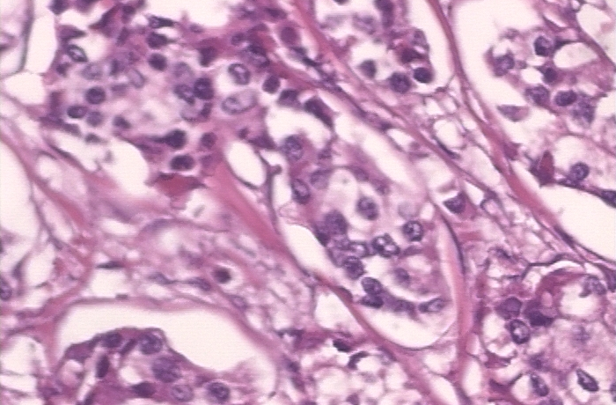
Motivation
Benign
Data Set – BREAKHIS :
  Histopathological Breast Cancer Images
  No. of Images : 7909
  Benign : 2480
  Malignant : 5429
Malignant
Notes:
Talk about
We wanted to do something that would have some real world impact.
And while we were researching the various data sets available, we came across this dataset.
The problem at hand was basically to classify the images as to whether they were benign or malignant by using computer aided diagnosis.

Slide 3
Background
The Problems associated with Breast Cancer Diagnosis are as follows:
  Average Concordance of only 75%.
  Time – Consuming, convoluted process.
  Requires highly specialized pathologists.
  Paper 1:
  A Dataset for Breast Cancer Histopathological Image Classification
  Concept of Computer Aided Diagnosis
  Four Different Classifiers : 1- Nearest Neighbor's, SVM’s and Random Forests, QDA.
  Accuracy between 80% - 85%

Slide 4
Background
Paper 2:
Classification of breast cancer histology images using Convolutional Neural Networks.
  Traditional approach : Hand Crafted Extraction methods
  Modern Approach : CNNs that learn useful features directly from the training image.
  (CNN+SVM) used for comparison purposes.
  Accuracies of 83.3% for Benign / Malignant are achieved.

Slide 5
Set-Up
 | Description
Spark Platform | Databricks
Spot Instances | Amazon EC2 Configuration : Driver node : p2.xlarge (beta) 61Gb, 1 GPU, 2 DBU Min – Max Workers : 2-8
Cloud Storage | Amazon S3
Deep learning Library | Keras with TensorFlow Backend
Pre-trained model used | Inception V3
Language | Pyspark

Slide 6
Spark Deep Learning Pipeline
It includes high-level APIs for common aspects of deep learning so they can be done efficiently in a few lines of code:
  Image loading: load millions of images into a DataFrame
  Applying pre-trained models as transformers in a Spark ML pipeline
  Transfer learning: Adapts a model trained for a similar tasks to the task at hand
  Distributed hyperparameter tuning
  Deploying models in DataFrames and SQL

Slide 7
Approach 1 : Using Spark Dl Libraries
Conversion of Image to Data Frames
Splitting the Data into Training, testing and Validation sets
Deep Image Featurizer
(Spark DL )
SVM / Logistic Regression
Train the Model on Training Set
Testing the Model
Deep Learning Pipeline

Slide 8
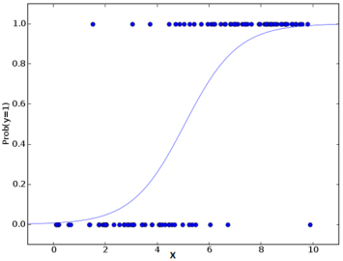
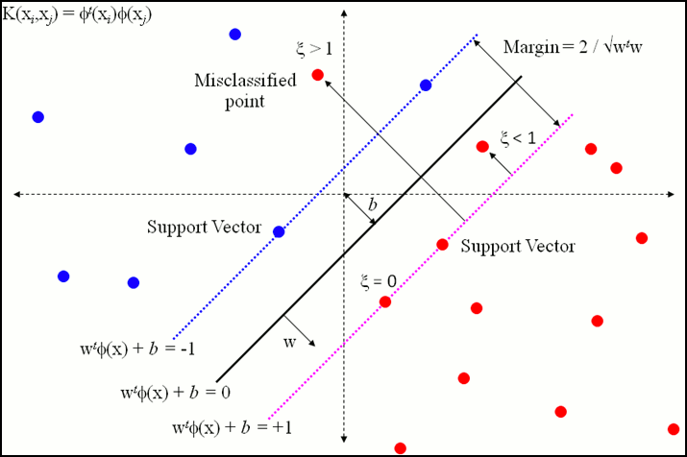
Classifiers
Logistic Regression:
Support Vector Machines:

Slide 9
Hierarchy of DL transformers for Images
Deep Image Featurizer
NamedImageTransformer(model_name)
KerasImageTransformer(keras.Model)
TFImageTransformer(tf.Graph)
model_name
Keras.Model
tf.Graph
Image
Output

Slide 10
TF Image Transformer
Defined by the tf.Graph
Convert ImageSchema data into a vector
Use tensorframes to :
Efficiently distribute tf.Graph to workers
Apply the graph to the partitioned data.
Return the result as a spark.ml.Vector

Slide 11
Approach 2: Using Keras
Defining the CNN Architecture
Training the CNN on Training Data
(Single Node)
Predictions using Keras Image File Transformer
(Distributed)
Probability of being Benign or Malignant
Pre-Process Training Data : Resize, Zooming & Shuffling

Slide 12
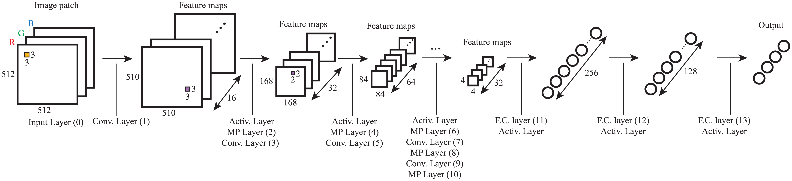
CNN Architecture
Source : Classification of breast cancer histology images using Convolutional Neural Networks

Slide 13
Results
Spark DL + Logistic Regression
Iterations | Run Time (mins) | Accuracy (%)
5 | 14.93 + 10.16 | 79.4
10 | 10.17 + 10.75 | 82.7
Spark DL + Support Vector Classifier
Iteration | Run Time (hrs) | Accuracy
5 | 1.44 | 80.46
10 | 2.54 | 81.96
Convolutional Neural Networks
Training Samples | Validation Samples | Epochs | Run Time (hrs) | Training Accuracy | Validation Accuracy
2872 | 397 | 25 | 7.76 | 85.51% | 91.93%
As per the reference paper the CNN model reported an accuracy of 77.6% for a training set of more than 4000 images over 50 epochs.

Slide 14
Challenges
Dataset : Complex Dataset requiring highly efficient featurizer.
Distributed CNN : Insufficient Documentation.
Limitations in Parallelizing Tensor Flow: Still an active area of research.
Architecting the ideal CNN model.
Finding a platform that can meet the computational need and provide the required libraries.

Slide 15
Future prospects
Identify not just the presence of Cancer, but also the type of cancer (i.e.) Adenosis, Fibroadenoma, Phyllodes or Tubular.
Identify the proliferation of Cancer cells through streaming images.
Implementing Real-Time Prediction using the trained model.
Enhancing Research in implementing distributed CNN’s on frameworks such as Tensorflow, Keras or Theano.

Slide 16
Thank You

Slide 17
Spark Deep Learning
Transfer Learning :
  A technique which adapts a model trained for a similar tasks to the task at hand.
  Eg. A model used for classifying cars can be used for classifying Trucks as well.
  We have used the Inception V3 pre-trained model:
    A model trained on the ImageNet dataset with 1000 classes.
  Deep Learning Featurizer:
  Transforms images to numeric features.
  Peels the last layer of the pre-trained neural network and uses the output of the previous layers as features for the classifier.

